Slide 1
디자인 구성 기획
작성자 : 유혜정

Slide 2
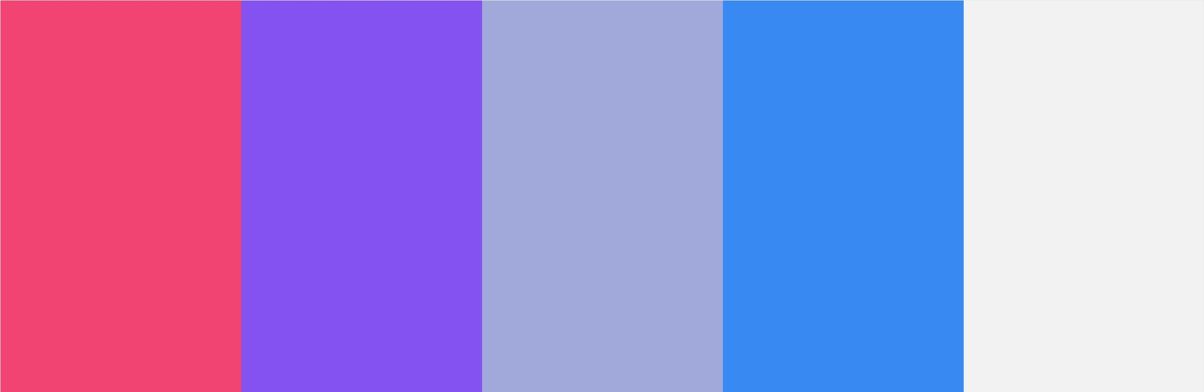
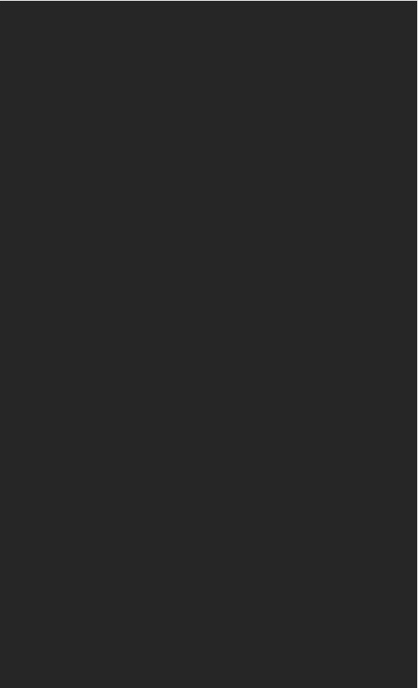

#F24472 #FDA30F #42B4E6 #045391 #F2F2F2 #262626
242,68,114/253,163,15/66,180,230/4,83,145/242,242,242/38,38,38

Slide 3
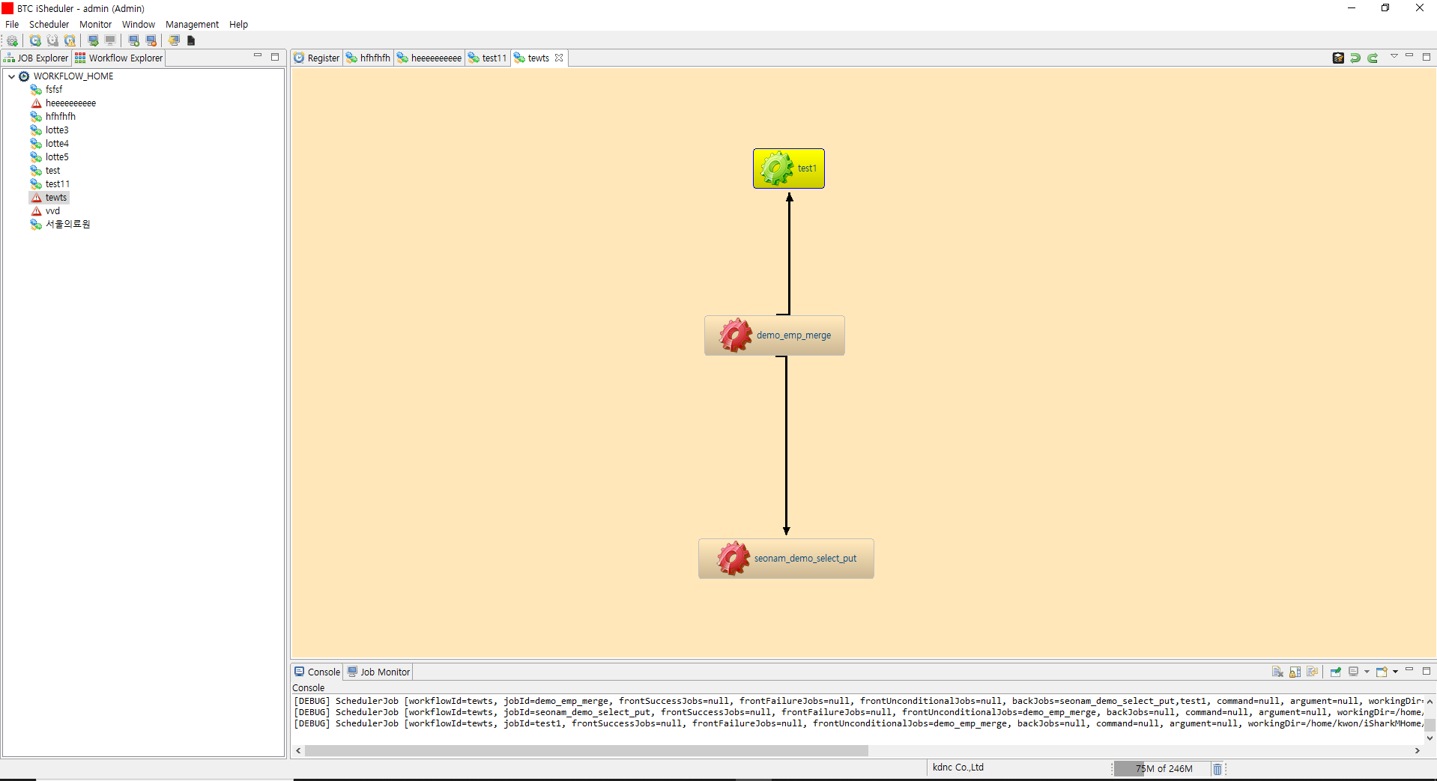

Slide 4
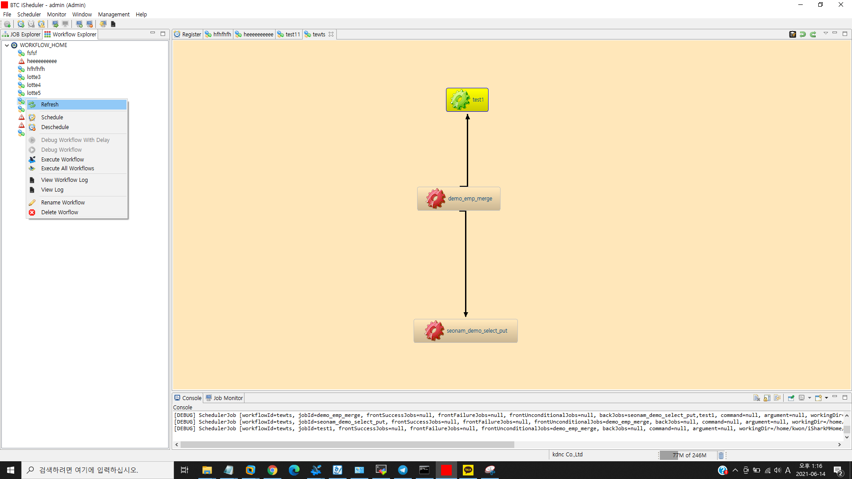

Slide 5
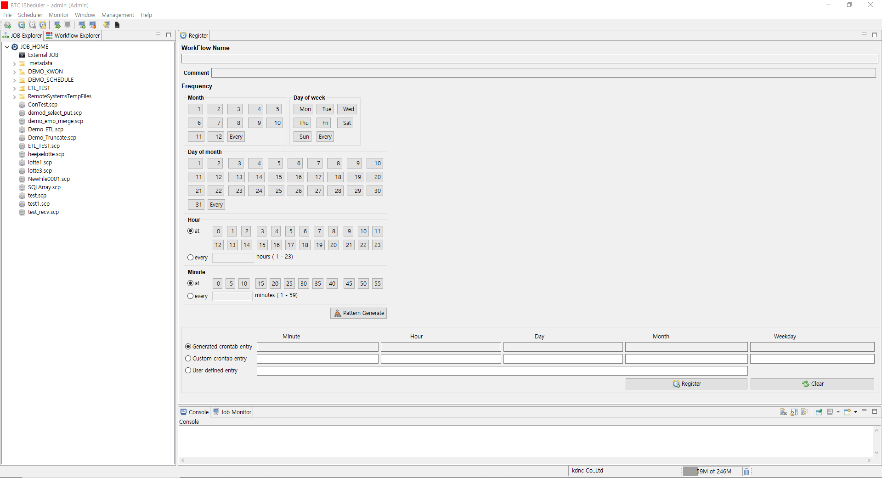

Slide 6
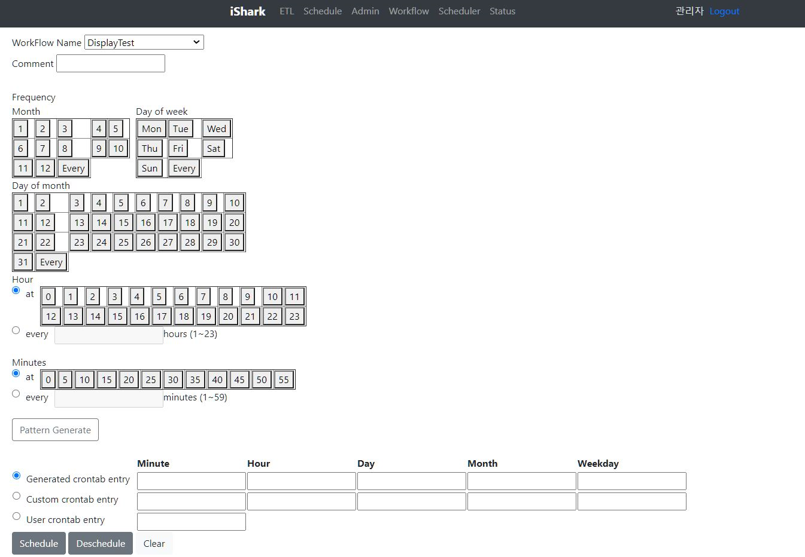
workflow 주기 설정 (AS-IS)
workflow 주기 설정 (TO-BE)

Slide 7
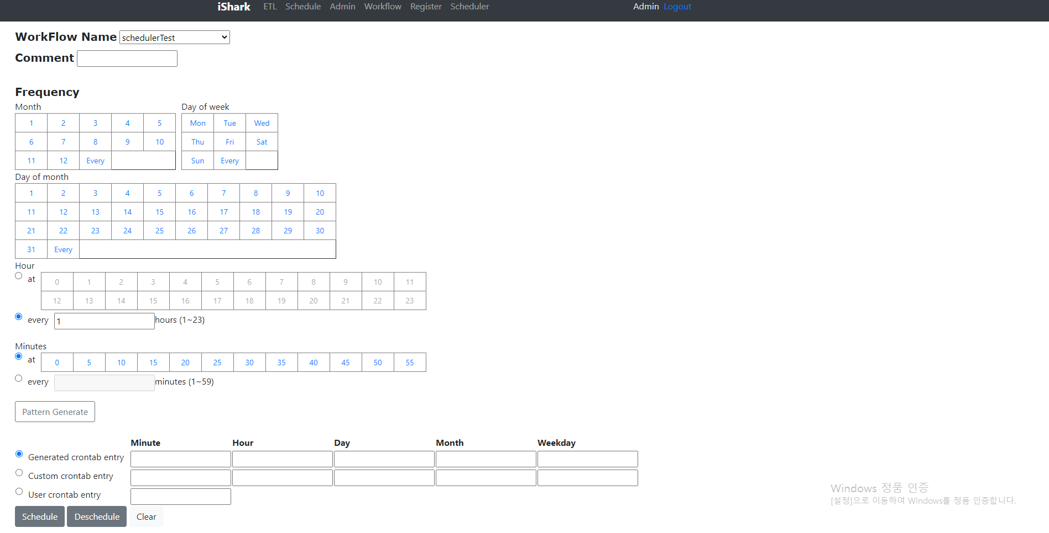

Slide 8
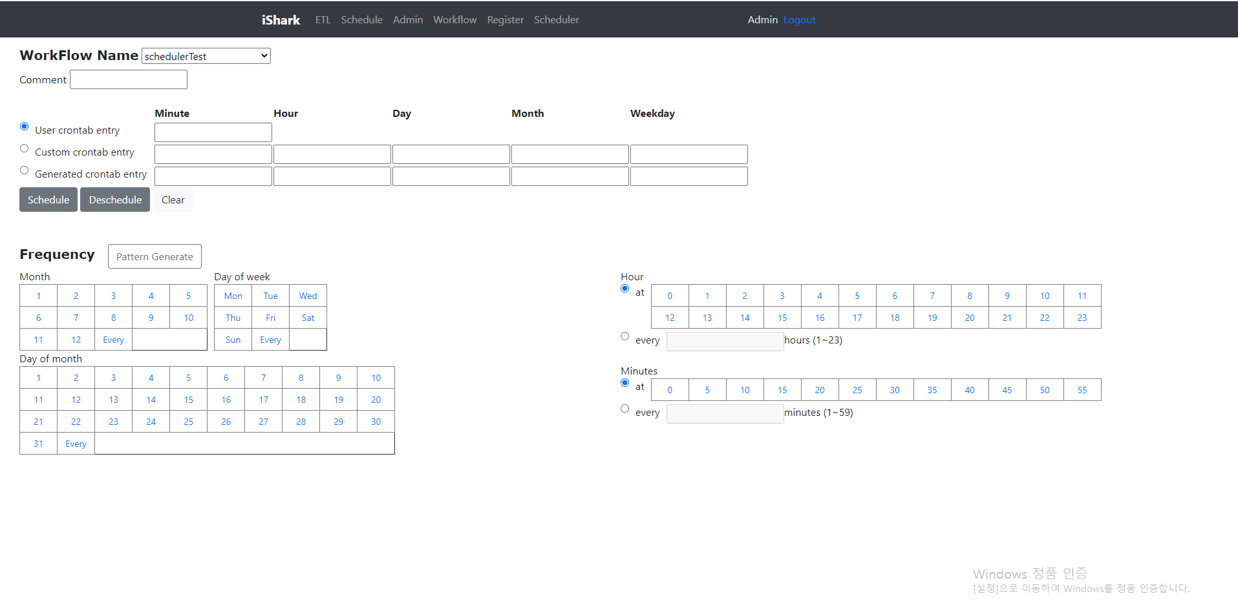

Slide 9
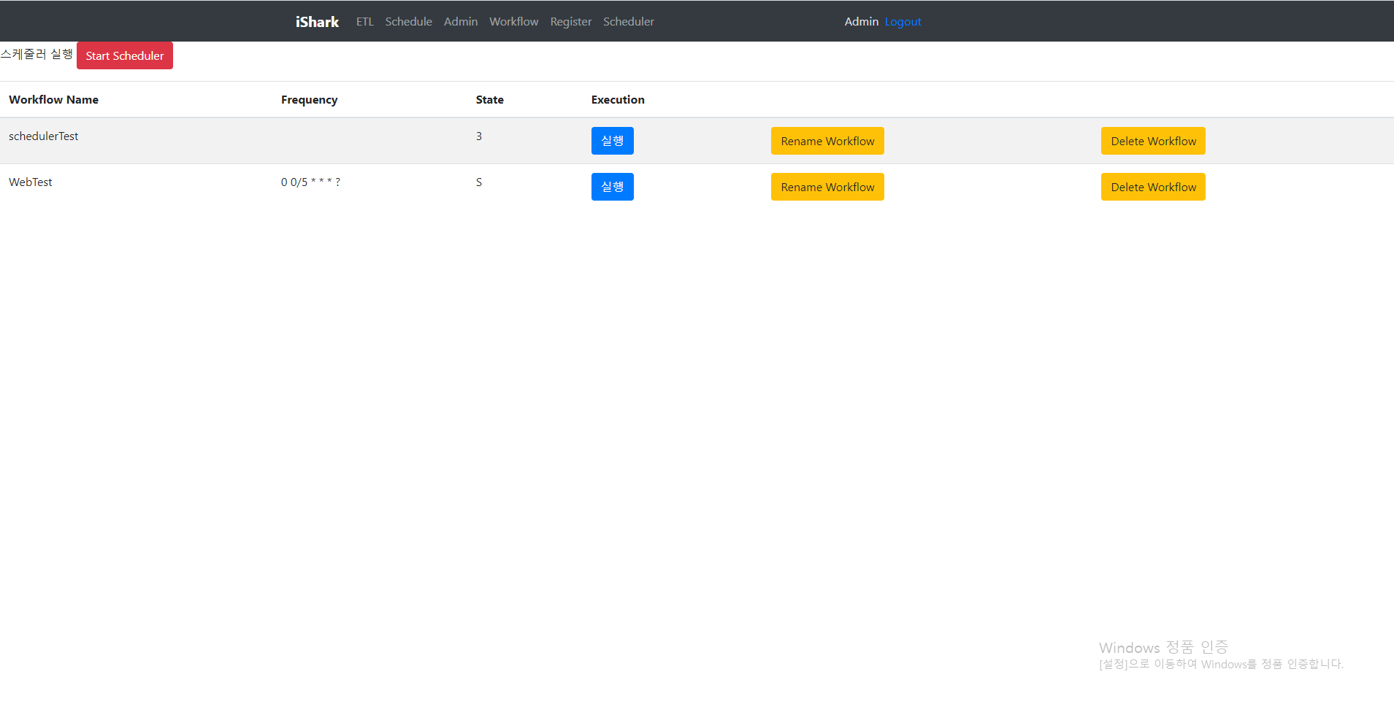

Slide 10
Scheduler
Off
On
Status
Workflow Name
Frequency
Action
3
S
S
S
wf_name1
wf_name2
wf_name3
wf_name4
0 0/5 * * * ?
0 0 0/5 * * ?
0 0 0/5 * * ?
0 0 0/5 * * ?
Rename
Delete
Rename
Delete
Rename
Delete
Rename
Delete

Slide 11
Scheduler
Off
On
Status
Workflow Name
Frequency
Action
3
S
S
S
wf_name1
wf_name2
wf_name3
wf_name4
0 0/5 * * * ?
0 0 0/5 * * ?
0 0 0/5 * * ?
0 0 0/5 * * ?
Rename
Delete
Rename
Delete
Rename
Delete
Rename
Delete

Slide 12
Scheduler
Off
On
Status
Workflow Name
Frequency
Action
3
S
S
S
wf_name1
wf_name2
wf_name3
wf_name4
0 0/5 * * * ?
0 0 0/5 * * ?
0 0 0/5 * * ?
0 0 0/5 * * ?
Rename
Delete
Minute Hour Day Month Week
0/5
*
*
*
?
* Per Minute
0/1 From ( ) Minute Start Per ( ) Minute
0-1 ( ) Minute To ( ) Per Minute
Specified ( 0 ) Minute
0
5
삭제 취소 저장
Rename
Delete
Rename
Delete
Rename
Delete

Slide 13
Scheduler
Off
On
Status
Workflow Name
Frequency
Action
3
S
S
S
wf_name1
wf_name2
wf_name3
wf_name4
0 0/5 * * * ?
0 0 0/5 * * ?
0 0 0/5 * * ?
0 0 0/5 * * ?
Rename
Delete
Minute Hour Day Month Week
0/5
*
*
*
?
* Per Day ? Any Day
0/1 From ( ) Day Start Per ( ) Day
0-1 ( ) Day To ( ) Per Day
Specified ( 0 ) Day
삭제 취소 저장
Rename
Delete
Rename
Delete
Rename
Delete

Slide 14
Scheduler
Off
On
Status
Workflow Name
Frequency
Action
3
S
S
S
wf_name1
wf_name2
wf_name3
wf_name4
0 0/5 * * * ?
0 0 0/5 * * ?
0 0 0/5 * * ?
0 0 0/5 * * ?
Rename
Delete
Minute Hour Day Month Week
0/5
*
*
*
?
* Every Day
? Any Day
Selected Days of the Week
일
월
화
수
목
금
토
삭제 취소 저장
Rename
Delete
Rename
Delete
Rename
Delete

Slide 15
Scheduler
Off
On
Status
Workflow Name
Frequency
Action
3
S
S
S
wf_name1
wf_name2
wf_name3
wf_name4
0 0 0/5 * * ?
0 0 0/5 * * ?
0 0 0/5 * * ?
Rename
Delete
Rename
Delete
Rename
Delete
Rename
Delete

Slide 16
Scheduler
Off
On
Status
Workflow Name
Frequency
3
S
S
S
wf_name1
wf_name2
wf_name3
wf_name4
0 0/5 * * * ?
0 0 0/5 * * ?
0 0 0/5 * * ?
0 0 0/5 * * ?

Slide 17
Scheduler
Off
On
Status
Workflow Name
Frequency
3
S
S
S
wf_name1
wf_name2
wf_name3
wf_name4
Rename
Delete
0 0/5 * * * ?
0 0 0/5 * * ?
0 0 0/5 * * ?
0 0 0/5 * * ?

Slide 18
Scheduler
Off
On
Status
Workflow Name
Frequency
3
S
S
S
wf_name1
wf_name2
wf_name3
wf_name4
0 0/5 * * * ?
0 0 0/5 * * ?
0 0 0/5 * * ?
0 0 0/5 * * ?
Minute Hour Day Month Week
0/5
*
*
*
?
* Per Minute
0/1 From ( ) Minute Start Per ( ) Minute
0-1 ( ) Minute To ( ) Per Minute
Specified ( 0 ) Minute
0
5
삭제 취소 저장

Slide 19
Scheduler
Off
On
Status
Workflow Name
Frequency
3
S
S
S
wf_name1
wf_name2
wf_name3
wf_name4
0 0/5 * * * ?
0 0 0/5 * * ?
0 0 0/5 * * ?
0 0 0/5 * * ?
Minute Hour Day Month Week
0/5
*
*
*
?
* Per Day ? Any Day
0/1 From ( ) Day Start Per ( ) Day
0-1 ( ) Day To ( ) Per Day
Specified ( 0 ) Day
삭제 취소 저장

Slide 20
Scheduler
Off
On
Status
Workflow Name
Frequency
3
S
S
S
wf_name1
wf_name2
wf_name3
wf_name4
0 0/5 * * * ?
0 0 0/5 * * ?
0 0 0/5 * * ?
0 0 0/5 * * ?
Minute Hour Day Month Week
0/5
*
*
*
?
* Every Day
? Any Day
Selected Days of the Week
일
월
화
수
목
금
토
삭제 취소 저장

Slide 21
Scheduler
Off
On
Status
Workflow Name
Frequency
3
S
S
S
wf_name1
wf_name2
wf_name3
wf_name4
0 0 0/5 * * ?
0 0 0/5 * * ?
0 0 0/5 * * ?

Slide 22
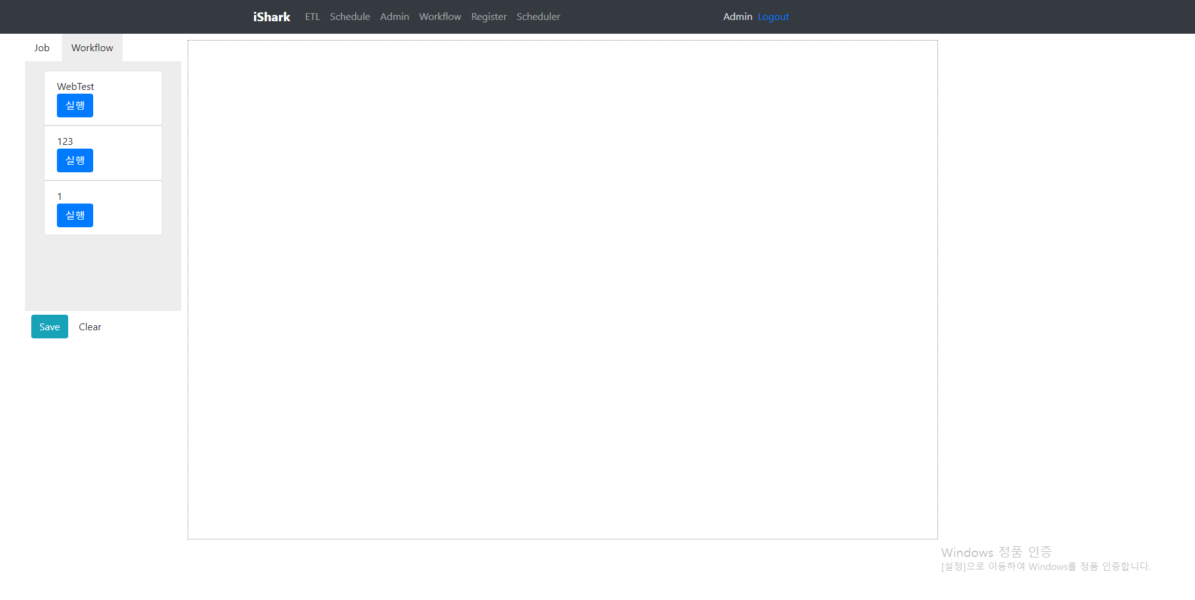

Slide 23
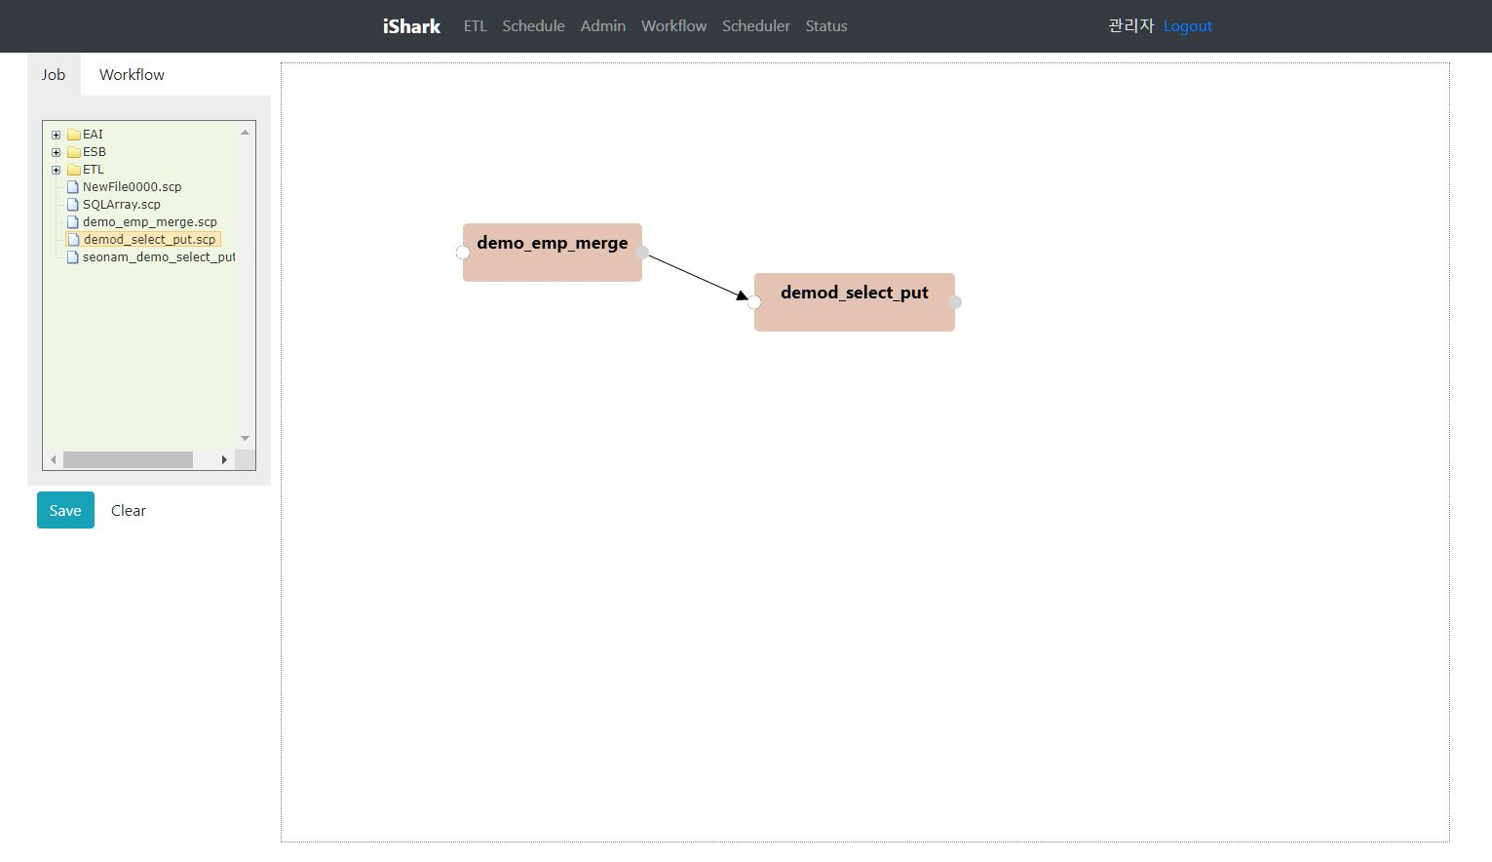

Workflow
wf_name1
wf_name2
wf_name3
wf_name4
wf_name5
wf_name6

Slide 24
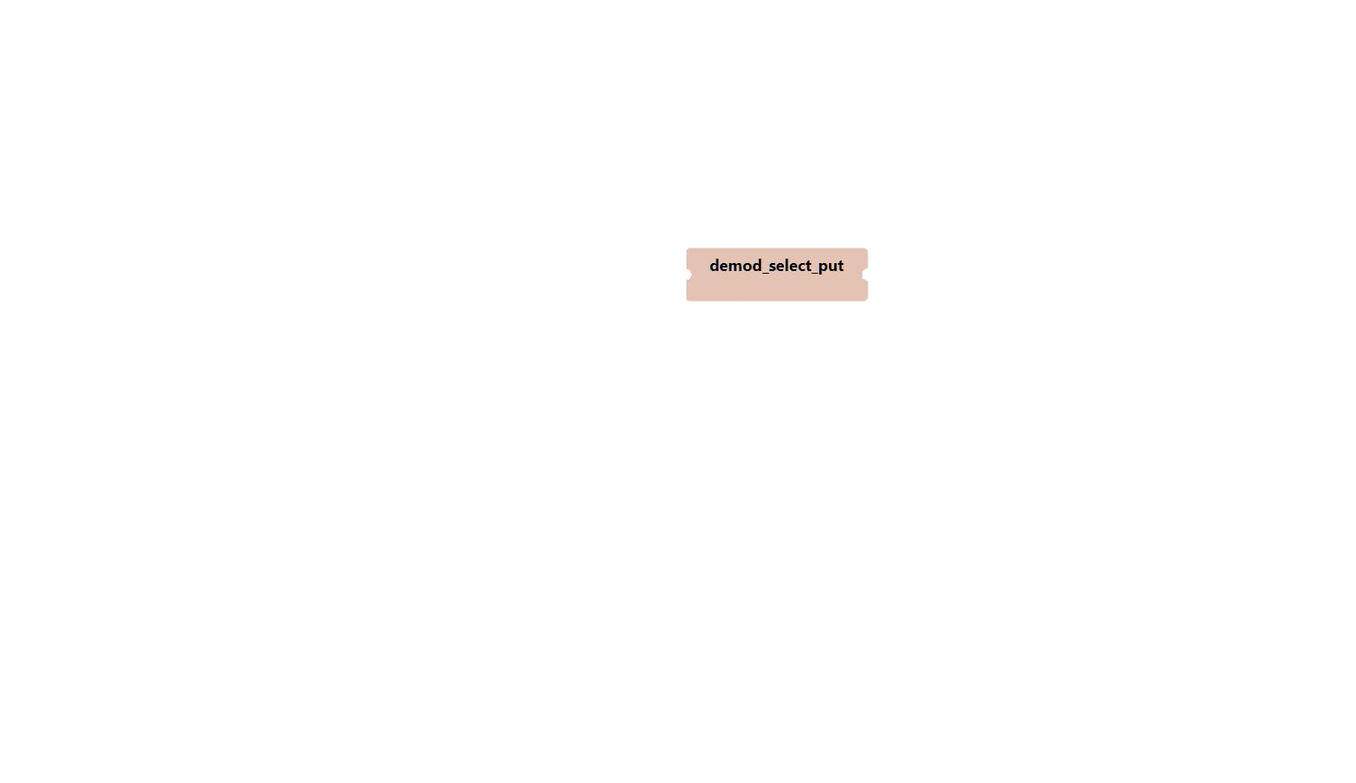
Workflow
wf_name1
wf_name2
wf_name3
wf_name4
X
>
wf_name5
wf_name6
Notes:
실시간으로 가능한지… 이게 어려움이 있음
실행버튼이 몇개까지 커스텀 기능적으로 가능한지 모름(본것같음 확실 ㄴㄴ)

Slide 25
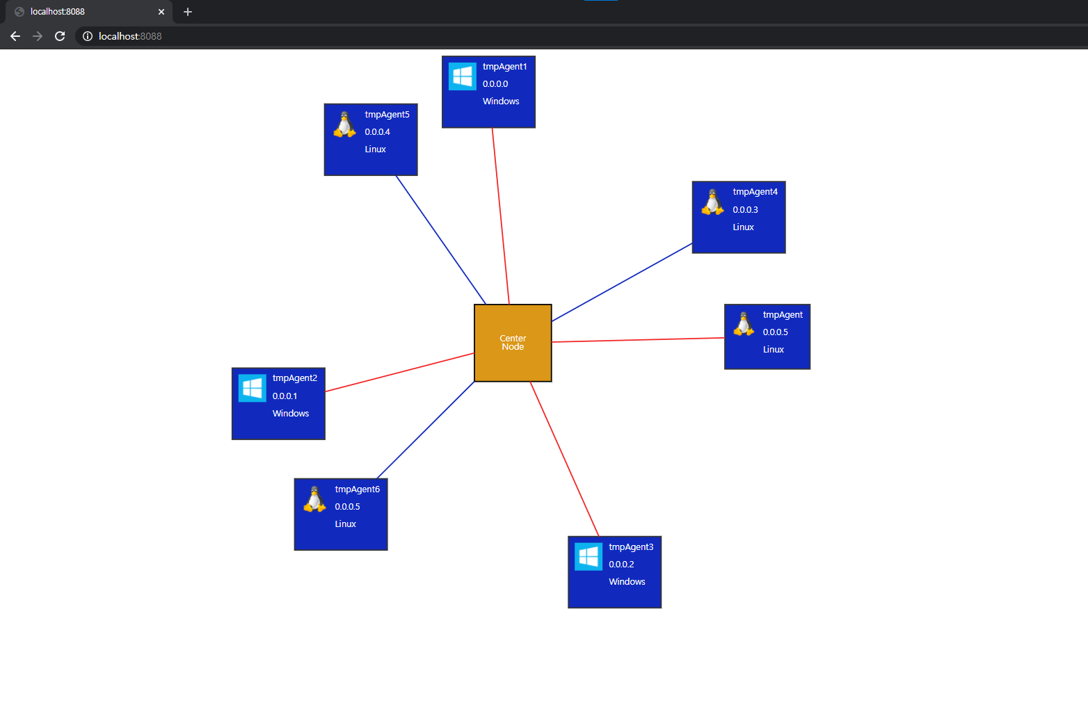
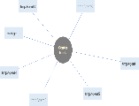
모니터링 부분(AS-IS)
모니터링 부분(TO-BE)
tmpAgent3
tmpAgent0
tmpAgent2
Center Node
색상
자동 V
자동
수동
tmpAgent1
tmpAgent4
tmpAgent5
tmpAgent6

Slide 26
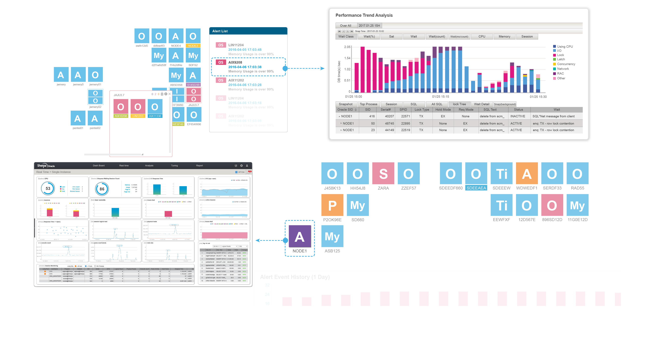

Slide 27
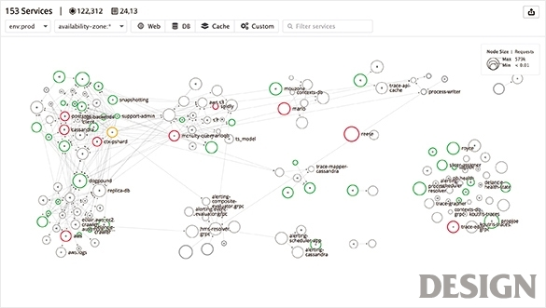
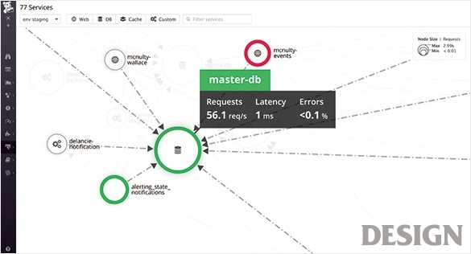
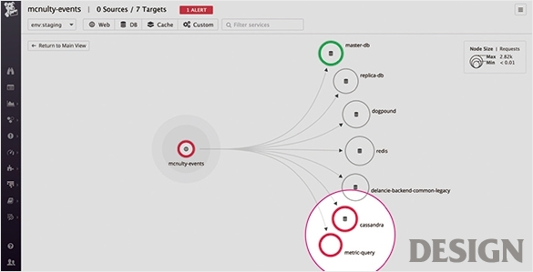

Slide 28
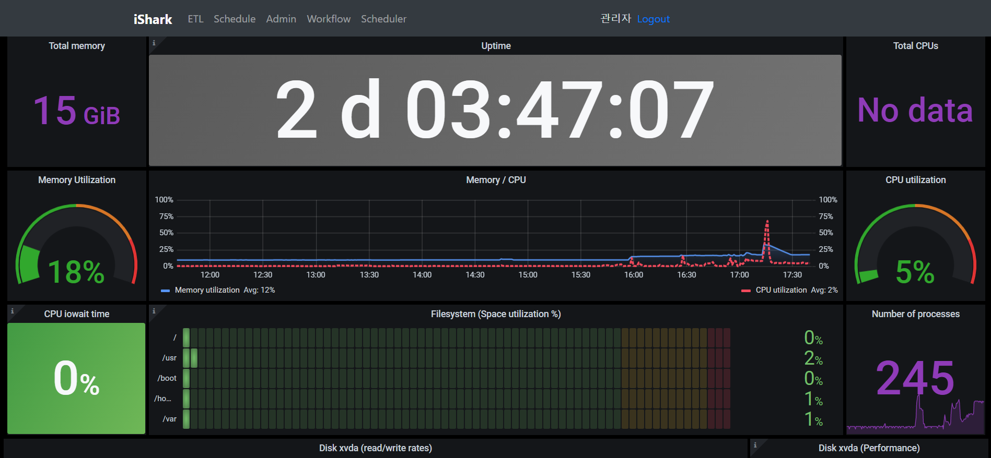
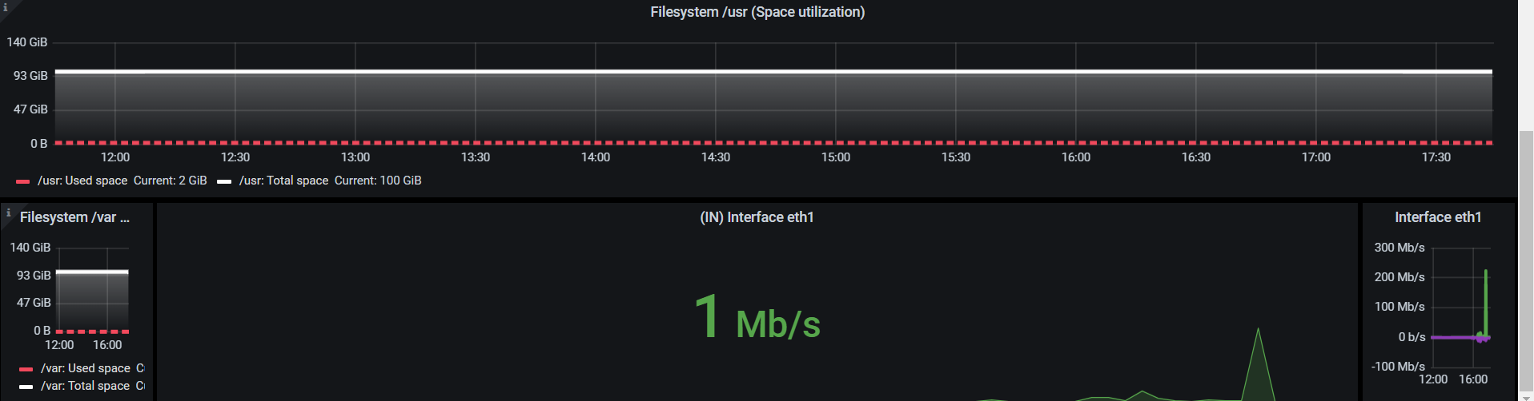

Slide 29
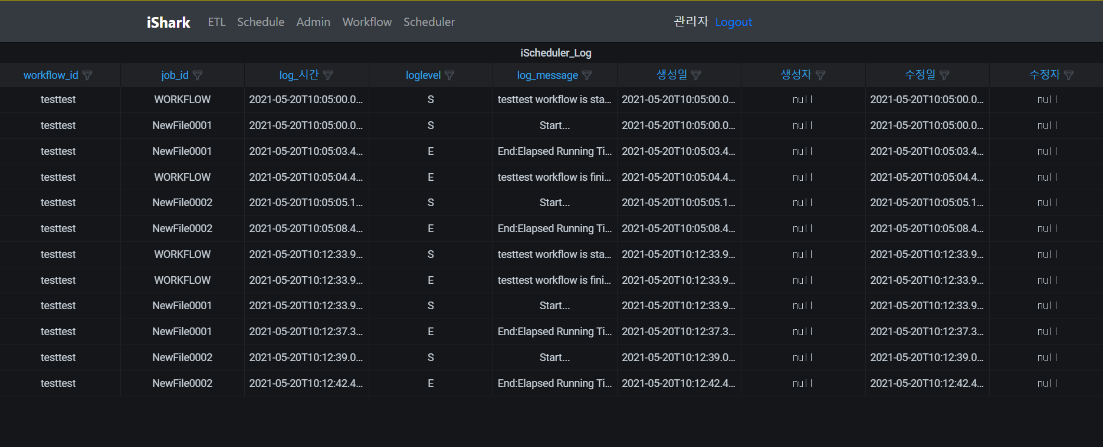
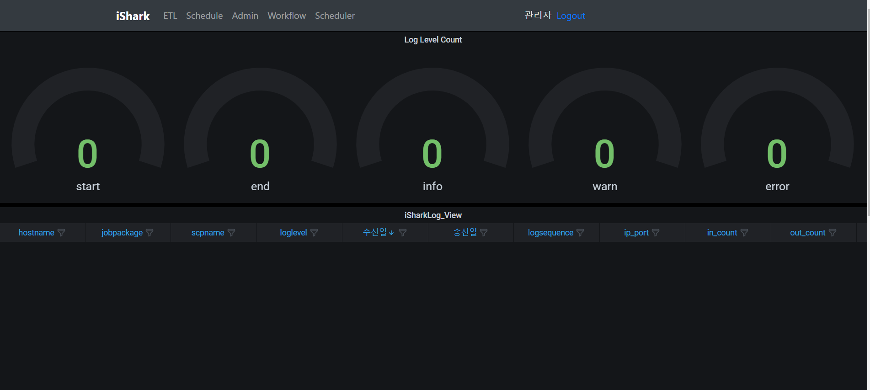

Slide 30
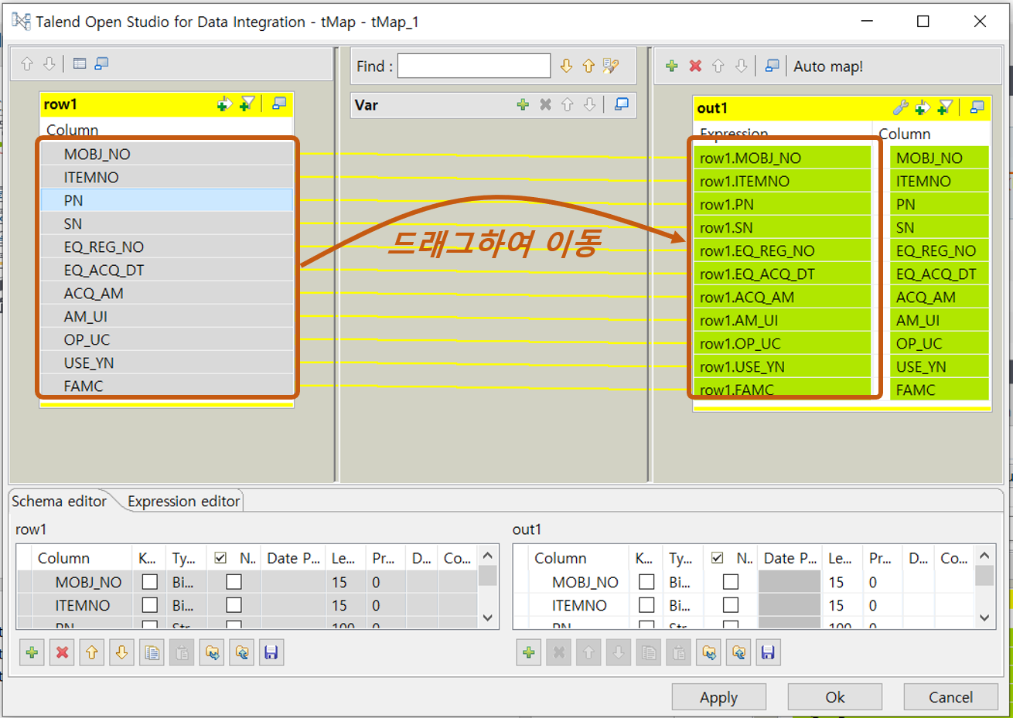
- 현재 ishark에 없는 기능

Slide 31
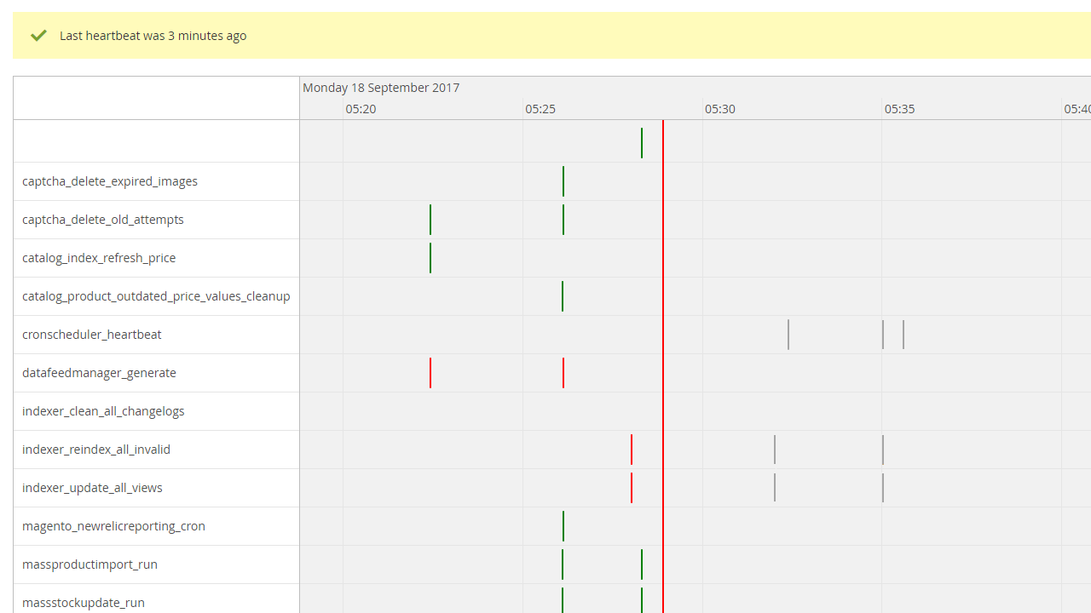

Slide 32
2
2
3
4
5
6
1
2
3
4
5
6
all
all
Month
AM
7
8
9
10
11
12
7
8
9
10
11
12
week
일
월
화
수
목
금
토
1
2
3
4
5
6
all
PM
1
2
3
4
5
6
7
8
9
10
11
12
7
8
9
10
11
12
Per
Hour
13
14
15
16
17
18
all
Date
0
5
10
15
20
25
19
20
21
22
23
24
all
Min
30
35
40
45
50
55
25
26
27
28
29
30
31
10
Per
Minute

